Slide 1
Flight delayS
Quixuan Wang, Karly Ringstad, Maryam Tabatabaei, John Jostes
WashU Data Bootcamp
June 2020

Slide 2
Data exploration
Motivation: We want to determine which airlines have the largest average delay in flights and compare delay times from before and after the coronavirus.
Original source: Kaggle.com
Too old
Only one year of data (2015)
Very large – 6 million rows
New source: Bureau of Transportation Statistics
Recent data
March 2019 and March 2020
1.2 million rows
https://transtats.bts.gov/ONTIME/Departures.aspx

Slide 3
Front end
HTML
- One main and three individual
- Utilizes d3, plotly, leaflet, geovoronoi and bootstrap libraries
Javascript
- Five files
- One for each visualization
- Config file to hold API Key
CSS
- Formats HTML elements

Slide 4
Back end
Python Scripts
- Data Extraction: Bureau of Transportation Statistics
- Transformation : Merge tables
- Load into PostgreSQL database
PostgreSQL Database
- Four tables
- Airline, Airport, Flight, Cancellation
- Via AWS
Python Flask
- app.py
- Pulls template and static files together to render data

Slide 5
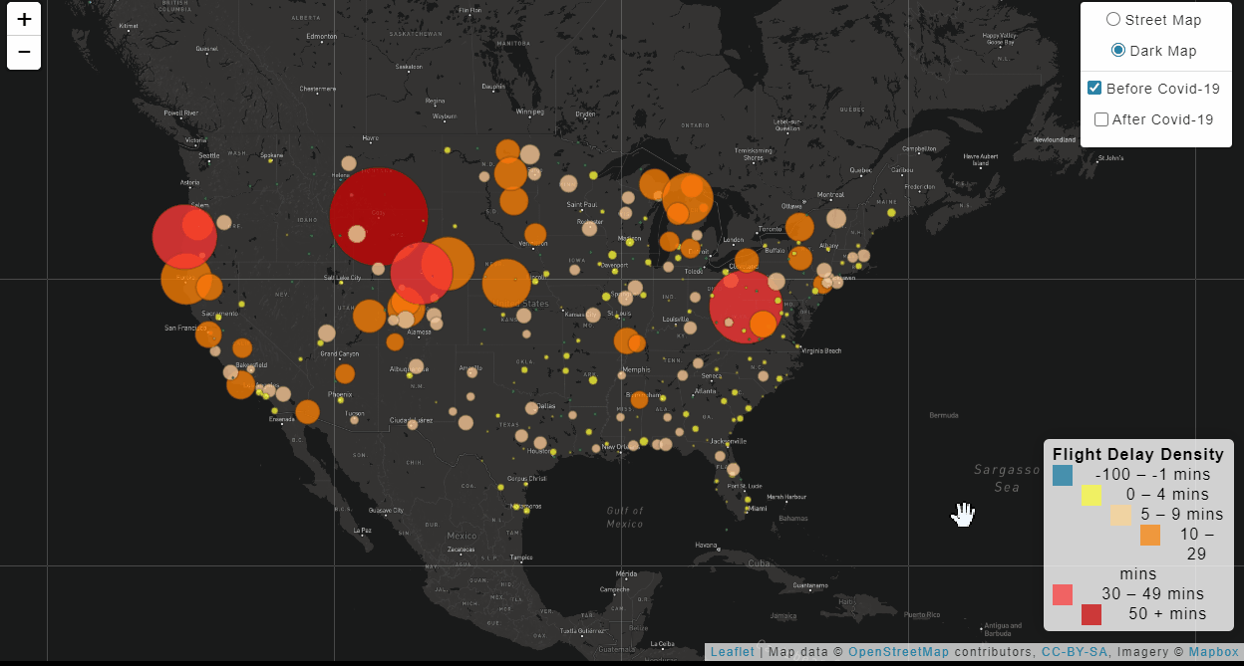
Bubble chart

Slide 6
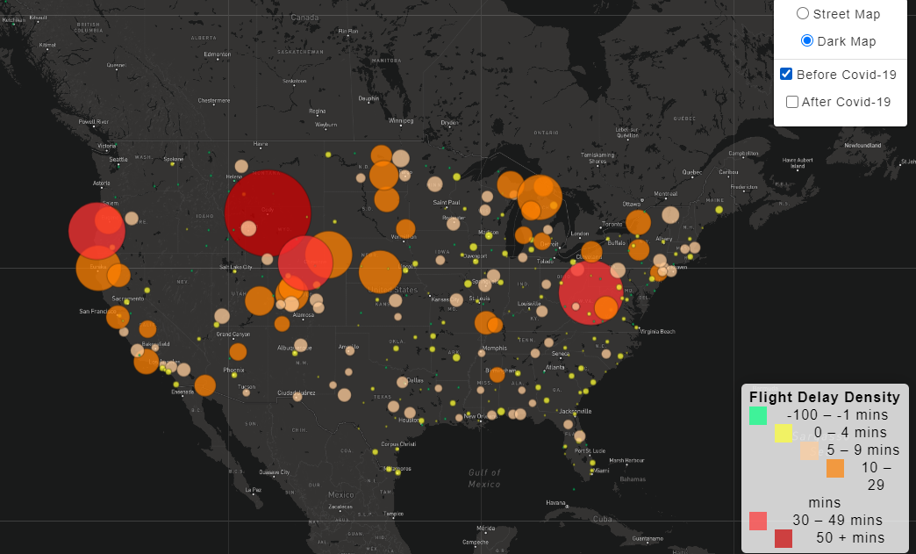
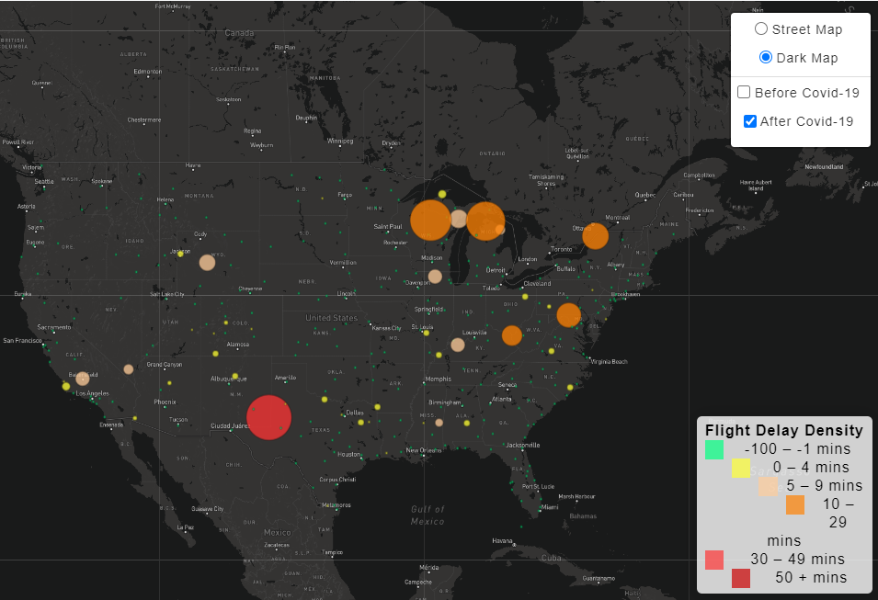
Bubble chart

Slide 7
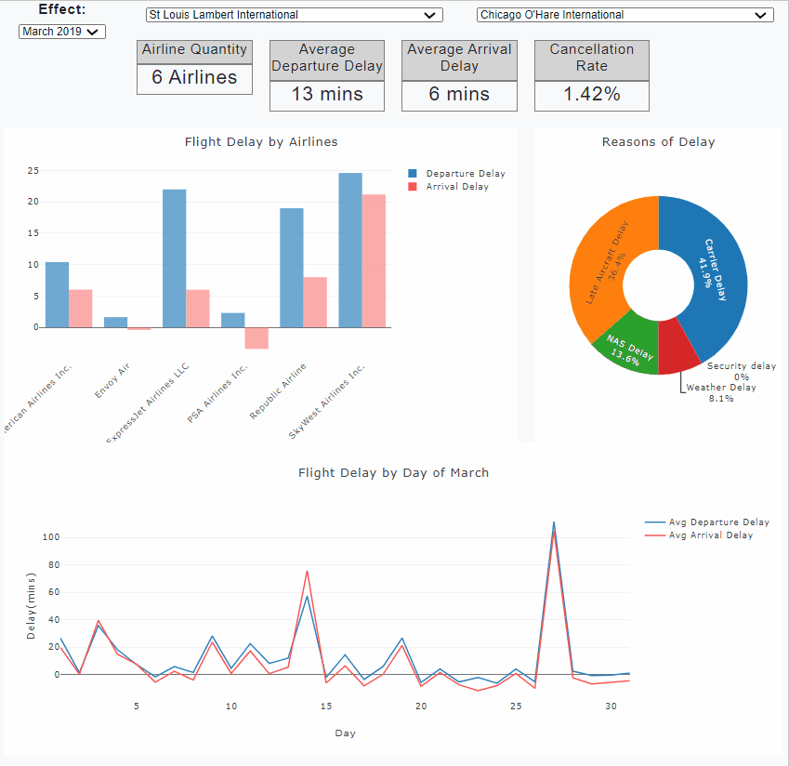
Dashboard

Slide 8
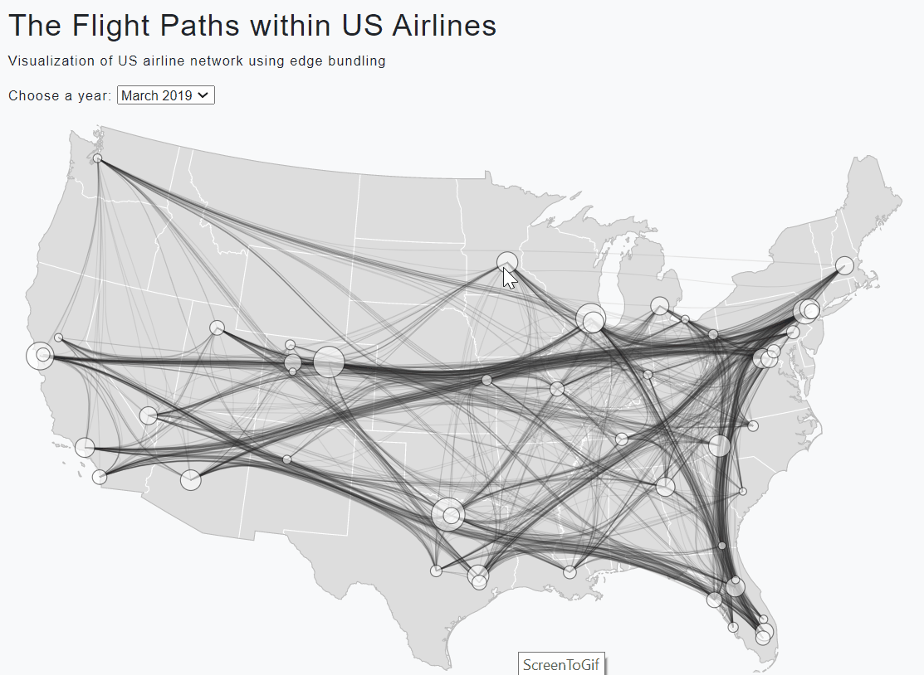
Flight Routes

Slide 9
conclusion
(larger/smaller) airports often leads to larger delay times.
Delay times post-covid drastically decrease
Cancellation increased post-covid
Top 5 Punctual Airlines :
American Airlines
Envoy Air
ExpressJet Airlines LLc
PSA Airlines
SkyWest Airlines
Deployed via Heroku
https://flight-delay-2020.herokuapp.com/

